Slide 1


Java ee
(ADVANCE JAVA)
Lecture-43

Slide 2
Today’s Agenda
Session Counter
Session Tracking Without Cookies
Event Handling In Session Tracking

Slide 3
EXERCISE
Write a web application containing a JSP page with two buttons titled “Next” and “Previous”. The page should display the default value as 0 and whenever the user clicks on any of the buttons this counter should be incremented or decremented respectively.

Slide 4
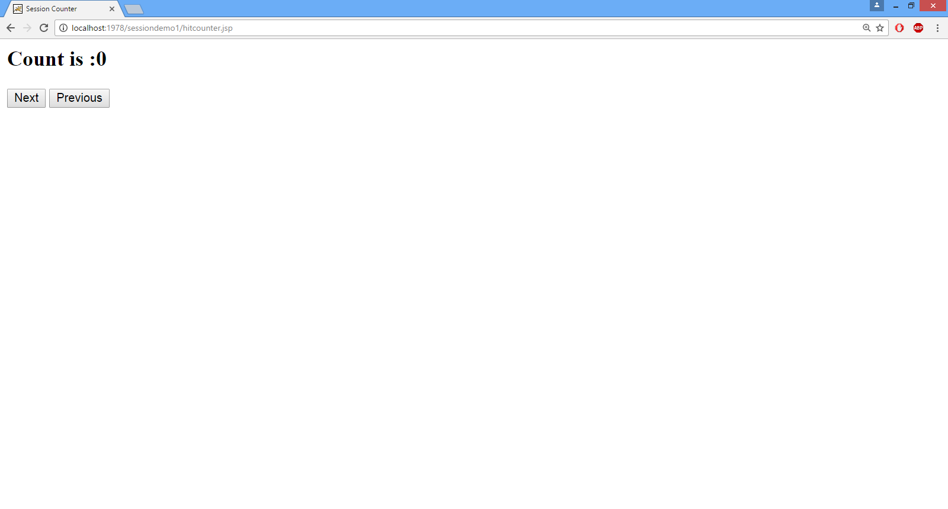
OUTPUT( default)

Slide 5
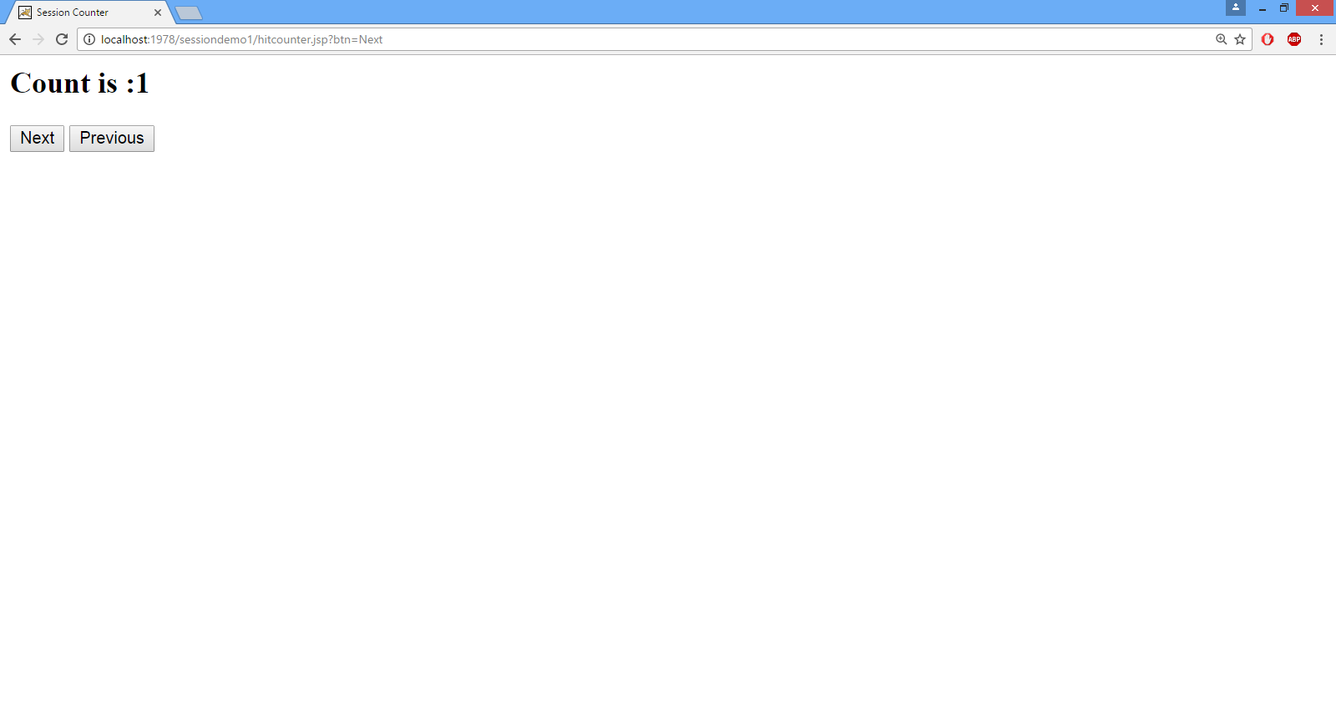
OUTPUT( after “Next”)

Slide 6

OUTPUT( after “Next”)

Slide 7

OUTPUT( after “Previous”)

Slide 8
SOLUTION
<html>
<head>
<title>Session Counter</title>
</head>
<body>
<%
HttpSession sess=request.getSession();
int count=0;
String btn=(String)request.getParameter("btn");
if(btn!=null)
{
if(sess.getAttribute("counter")!=null)
{
String cval=(String)sess.getAttribute("counter");
if(btn.equals("Next"))
count=Integer.parseInt(cval)+1;
else
count=Integer.parseInt(cval)-1;
}
}

Slide 9
SOLUTION
sess.setAttribute("counter",String.valueOf(count));
out.println("<h2>Count is :"+count+"</h2>");
%>
<form action="hitcounter.jsp">
<input type="submit" name="btn" value="Next">
<input type="submit" name="btn" value="Previous">
</form>
</body>
</html>

Slide 10
SESSION TRACKING WITHOUT COOKIES
Whenever we implement session tracking using session API , the container creates a cookie called jsessionid and returns it back to the browser .
Now , when the browser revisits the same page it sends back this cookie and the container fetches the sessionid from the cookie , pulls out appropriate session object from the session pool and makes it available to us .

Slide 11
SESSION TRACKING WITHOUT COOKIES
Thus we can observe that cookie plays a very important role in session tracking .
But , if the user disables cookie settings in his browser then session tracking will fail.

Slide 12
SESSION TRACKING WITHOUT COOKIES
To overcome this , java provides us a technique called URL Encoding .
In this technique we create all our clickable elements ( buttons and anchors) in such a way that they not only contain the URL of the target page but also the session id .
Thus whenever the user will click them , the server will get the session id

Slide 13
SESSION TRACKING WITHOUT COOKIES
URL Encoding can be done in 2 ways:
Manually
In this approach we manually generate session id and attach it in our URL :
<%
String url ;
url=“hitcounter.jsp;jsessionid=“+sessionobj.getId();
%>
<form action=“<%= url %>”>

Slide 14
SESSION TRACKING WITHOUT COOKIES
Using the method encodeUrl()
This method belongs to response object and accepts the URL of our page and returns the same URL which session id appended to it.
<%
String url;
url=response.encodeUrl(“hitcounter.jsp”);
%>
<form action=“<%=url%>”>

Slide 15
EVENT HANDLING IN SESSION MANAGEMENT
While developing a web application whenever we apply session tracking then there are many events which are fired in the lifetime of session object.
For example: creation and destruction of a session object executes two methods which are :
sessionCreated() and
sessionDestroyed()

Slide 16
EVENT HANDLING IN SESSION MANAGEMENT
These methods belong to the interface HttpSessionListener.
Now if we want to handle these events then we have to do the following:
Create a class which implements HttpSessionListener .
Overrride the sessionCreated() and sessionDestroyed () method .

Slide 17
EVENT HANDLING IN SESSION MANAGEMENT
Create web.xml file containing the listener tag with the name of listener class .
Create appropriate directory structure as we did with servlet and place the package code within classes folder.

Slide 18
EXERCISE
Write a web application containing a JSP page which displays total number of users online i.e how many users are currently connected to the server.

Slide 19
SOLUTION(The Listener class)
package mylistener;
import javax.servlet.http.*;
public class UserCount implements HttpSessionListener
{
public static int count;
public void sessionCreated(HttpSessionEvent e)
{
++count;
}
public void sessionDestroyed(HttpSessionEvent e)
{
--count;
}
}

Slide 20
SOLUTION(The web.xml file)
<web-app>
<listener>
<listener-class>
mylistener.UserCount
</listener-class>
</listener>
</web-app>

Slide 21
SOLUTION(The home.jsp page)
<%@ page import="mylistener.*" %>
<html>
<head>
</title>Session Counter</title>
</head>
<body>
<%
out.println("<h2>Total Users Currently online are:"+UserCount.count+" </h2>");
%>
</body>
</html>

Slide 22

End Of Lecture
For any queries mail us @: scalive4u@gmail.com
Call us @ : 0755-4271659, 7879165533
Agenda for Next Lecture:
Introduction To Java Bean
Creating Bean Object
Bean setter and getter Methods
Using Beans With HTML

